Slide 1

LINE FOLLOWING ROBOT
Candidates
Guided By
Harshad Ade
Anish Bansod
Anveksha Sukhadeve
Swaraj Bhaganagare
Amruta Bharamgude
C. D. PATIL

Slide 2
2
INTRODUCTION
The line following robot is the self-operating intelligent machine that follows a drawn line on a floor area and the path line can be visible as black on a white surface area; or a white line on the black surface area. It is an autonomous robot which identify and tracks either on a black line in white surface area or a white line in black surface area. Line following robot must be able to detect a specified line and maintain track on it and do the assign jobs. For performing job, the given path line must be followed by the designed and developed robot for special situations. The developed system composed of input, process and output parts. First read the black/white or white/black path on considered floor and take input signal for transmission into microcontroller (Arduino UNO) in a process that can be asked and made the decisions. Microcontroller decided based on the received inputs that can change (if needed) to be made directions or speeds of the robot. It converts the result to any directions which can be sent to the line follower speed. The system sends the first or previous adjusted control signals to speed and directions of line follower robot. For line sensing operation, IR sensors are the ones which are widely used for the development of a line follower robot.

Slide 3
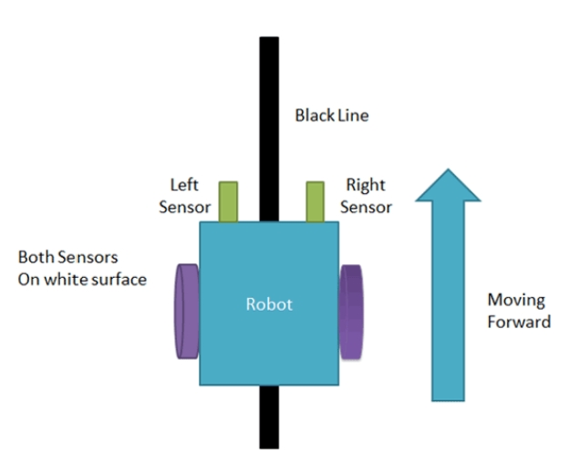
4
LINE FOLLOWING PRINCIPLE
Here in this line follower robot we are using two IR sensor modules left sensor and right sensor. When both left and right sensor senses white then robot move forward. If left sensor comes on black line, then the robot turns left side in the black line. . If right sensor sense black line, then the robot turn right side until both sensors at white surface. When white surface comes robot starts moving on forward again. If both sensors come on black line, robot stops.
MOVE FORWARD

Slide 4
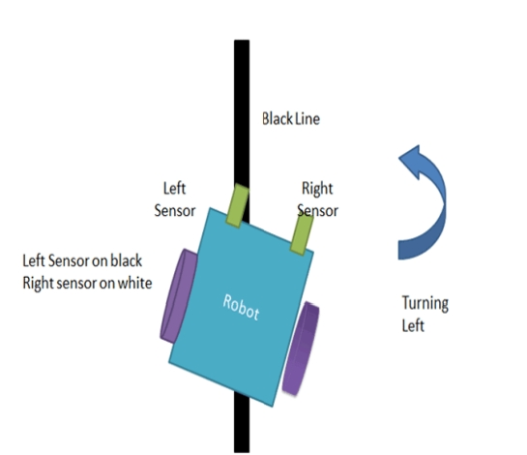
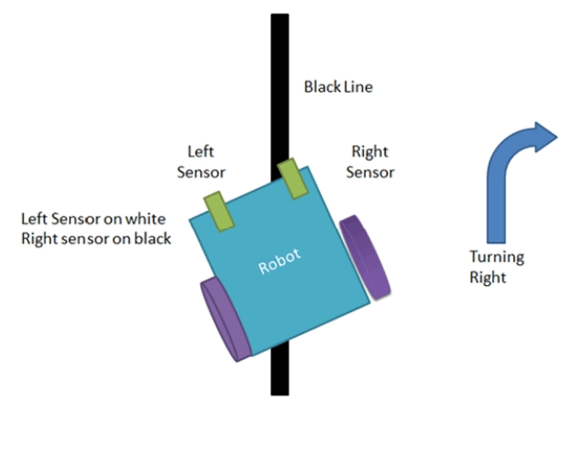
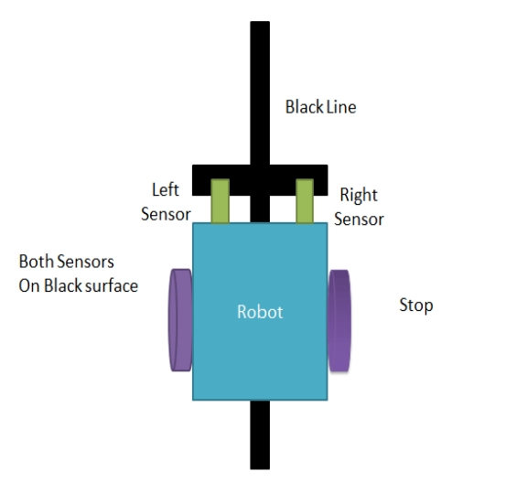
TURN LEFT SIDE
TURN RIGHT SIDE
STOP

Slide 5
List of Components
Arduino UNO R3
IR Sensor
L298D Motor Driver
Wheels
Body
Switch
100 RPM Motors
Lithium Ion Battries
Sound Alarm

Slide 6
Arduino UNO R3
Arduino UNO is a microcontroller board based on the ATmega328P. It has 14 digital input/output pins (of which 6 can be used as PWM outputs), 6 analog inputs, a 16 MHz ceramic resonator, a USB connection, a power jack, an ICSP header and a reset button. It contains everything needed to support the microcontroller; simply connect it to a computer with a USB cable or power it with a AC-to-DC adapter or battery to get started. You can tinker with your UNO without worrying too much about doing something wrong.
IR Sensor
An infrared sensor is an electronic device, that emits in order to sense some aspects of the surroundings. An IR sensor can measure the heat of an object as well as detects the motion. These types of sensors measure only infrared radiation, rather than emitting it that is called a passive IR sensor. Usually, in the infrared spectrum, all the objects radiate some form of thermal radiation.
L298D Motor Driver
The L298 is an integrated monolithic circuit in a 15-lead Multiwatt and PowerSO20 packages. It is a high voltage, high current dual full-bridge driver designed to accept standard TTL logic levels and drive inductive loads such as relays, solenoids, DC and stepping motors. Two enable inputs are provided to enable or disable the device independently of the input signals. The emitters of the lower transistors of each bridge are connected together and the corresponding external terminal can be used for the connection of an external sensing resistor. An additional supply input is provided so that the logic works at a lower voltage.

Slide 7
Motors
100 RPM 12V Center Shaft DC Gear Motor are generally a simple DC motor with a gearbox attached to it. This can be used in all-terrain robots and variety of robotic applications. These motors have a 3 mm threaded drill hole in the middle of the shaft thus making it simple to connect it to the wheels or any other mechanical assembly.
Lithium Ion Battery
A lithium-ion or Li-ion battery is a type of rechargeable battery which uses the reversible reduction of lithium ions to store energy. Compared to other rechargeable battery technologies, Li-ion batteries have high energy densities, low self-discharge, and no memory effect.
Sound Alarm
A buzzer or beeper is an audio signaling device, which may be mechanical, electromechanical, or piezoelectric (piezo for short). Typical uses of buzzers and beepers include alarm devices, timers, train and confirmation of user input such as a mouse click or keystroke..

Slide 8
Working
A line following robot follows a line using infrared sensor. Motor is used to drive the wheels of the robot. Arduino UNO microprocessor receives the input from the sensor and controls the motor based on the sensors. Batteries are used to supply power to operate the robot. The robot is placed on the surface with a line. The line sensor continuously detects the line on the surface. The Arduino UNO determines whether the robot is on the line or not. The robot uses IR sensor, which continuously emits infrared light to read the line. We use the infrared light on the black line or the white surface. The white surface reflects all the light that fall on it, whereas the black color absorb all the light. In the line follower we use an IR transmitter and a receiver, which are used to identify the line. When IR rays fall on white surface it is reflected towards IR receiver, and when IR rays fall on black surface it absorbs all the rays. If the robot is off the line the Arduino UNO sends signal to the motor to adjust the direction of the robot until the line is detected. If the robot is on the line Arduino UNO sends signal to the motor to move. If IR rays are not reflected back then it concludes that it has some obstacle in front of it and has to stop. In the project when IR sensor senses a white surface the Arduino UNO gets 1(high) as an input and when it senses a black line Arduino gets 0(low) as an input. Based on these inputs an Arduino Uno provides the proper output to controls. The robot continues to follow the line until it reaches the end of the line and it's specific destination.

Slide 9
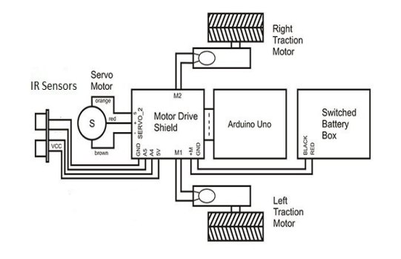
Animation of a Line Follower Robot
BLOCK DIAGRAM

Slide 10
Construction
To make this robot, first we need a robot body.
Now, place the BO motors to the chassis with the help of some hot glue.
Next step is to place the motor driver on chassis and connect the motor wires to the output of the motor driver.
Bend the IR LED and the sensor as per the requirement.
Then place the sensors on the downside of the robot, and adjust the sensors according to the track width and robot width. Remember that one sensor is for left side detection and the other one is for the right side detection.
Now place the Arduino UNO using glue and connect the sensor output pins to digital pin 2 and 4 of the Arduino.
Connect the VCC pins to 5volt and the ground pins to ground.
Now, connect the enable pins of the motor driver to pin 5 and 8 of Arduino UNO and connect the motor driver input pins to pin number 6, 7, 9 and 10 of Arduino UNO respectively.

Slide 11
CODE
int left_sensor = 2; // Left IR Proximity Sensor Signal Pin connected to Arduino Pin 2
int right_sensor = 3; // Right IR Proximity Sensor Signal Pin connected to Arduino Pin 3
int left_motor = 5; // Left Motor Pin connected to Arduino Pin 5
int right_motor = 6; // Right Motor Pin connected to Arduino Pin 6
void setup()
{
pinMode(left_sensor, INPUT); // Set Left IR Proximity Sensor Signal Pin as Input
pinMode(right_sensor, INPUT); // Set Right IR Proximity Sensor Signal Pin as Input
pinMode(left_motor, OUTPUT); // Set Left Motor Pin as Output
pinMode(right_motor, OUTPUT); // Set Right Motor Pin as Output
}
void loop()
{
if(digitalRead(left_sensor) == LOW && digitalRead(right_sensor) == LOW) // If both sensors are on black line
{
digitalWrite(left_motor, HIGH); // Move Forward Left Motor
digitalWrite(right_motor, HIGH); // Move Forward Right Motor
}

Slide 12
if(digitalRead(left_sensor) == HIGH && digitalRead(right_sensor) == LOW) // If left sensor is on white surface and right sensor is on black line
{
digitalWrite(left_motor, LOW); // Stop Left Motor
digitalWrite(right_motor, HIGH); // Move Forward Right Motor
}
if(digitalRead(left_sensor) == LOW && digitalRead(right_sensor) == HIGH) // If left sensor is on black line and right sensor is on white surface
{
digitalWrite(left_motor, HIGH); // Move Forward Left Motor
digitalWrite(right_motor, LOW); // Stop Right Motor
}
if(digitalRead(left_sensor) == HIGH && digitalRead(right_sensor) == HIGH) // If both sensors are on white surface
{
digitalWrite(left_motor, LOW); // Stop Left Motor
digitalWrite(right_motor, LOW); // Stop Right Motor
}
}

Slide 13
Sources
https://circuitdigest.com/microcontroller-projects/arduino-uno-line-follower-robot#:~:text=Circuit%20Diagram%20and%20Assembling%20the,the%20onboard%20op%2Damp%20comparator.
https://www.fierceelectronics.com/sensors/what-ir-sensor
https://docs.arduino.cc/hardware/uno-rev3
https://www.youtube.com/watch?v=PyKAanh_f30

Slide 14
THANK YOU

